Slide 1

BANkRuPTCY PREVENTION
TEAM MEMBERS :
ANANYA Biswas
MS. Shunottara alhat
MS. Shital laxman auti
MS. Pratiksha ram deshmukh
Mentor name : Priyanka gupta

Slide 2

BUSINESS PROBLEM : We have to calculate or check whether the business is going to bankrupt or not
OBJECCTIVE :
It is a classification project , since the variable to predict is binary (bankruptcy or non-bankruptcy). The goal here is to model the probability that a business goes bankrupt from different features.
The data file contains 7 features about 250 companies.

Slide 3
PROJECT FLOW / PROJECT ARCHITECHTURE
Collection of data
Business Understanding
Exploratory Data Analysis-EDA
Deployment
Model Building

Slide 4
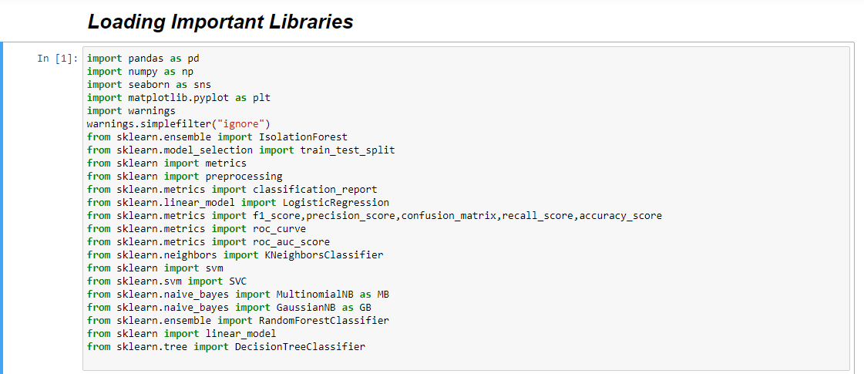
Importing Libraries
)

Slide 5
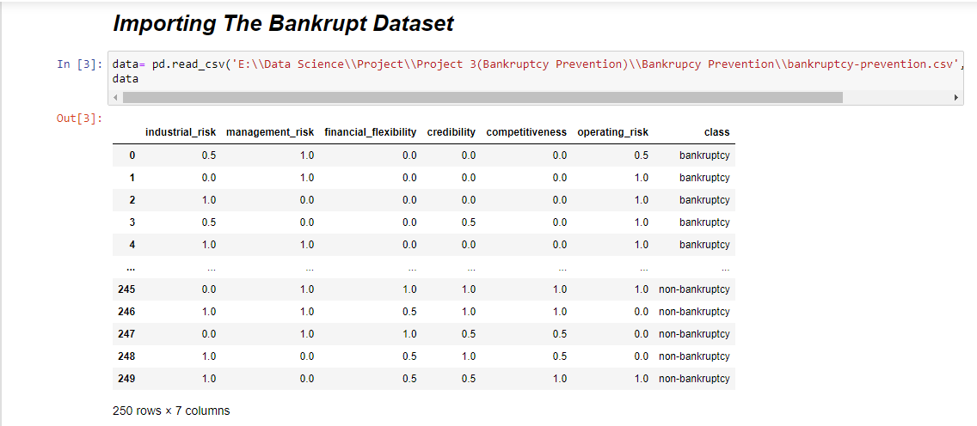
DATA SET DETAILS

Slide 6
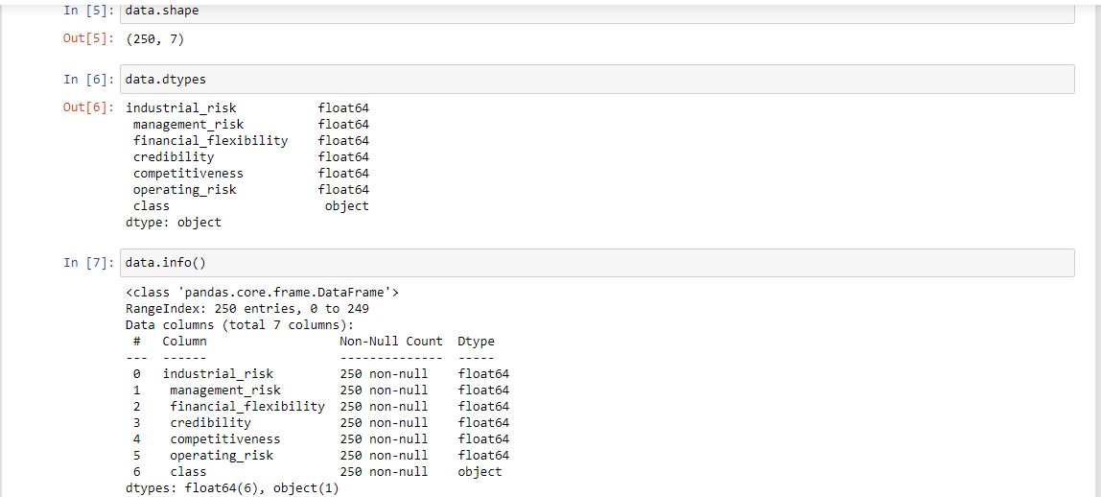
EXPLORATORY DATA ANALYSIS(EDA)

Slide 7
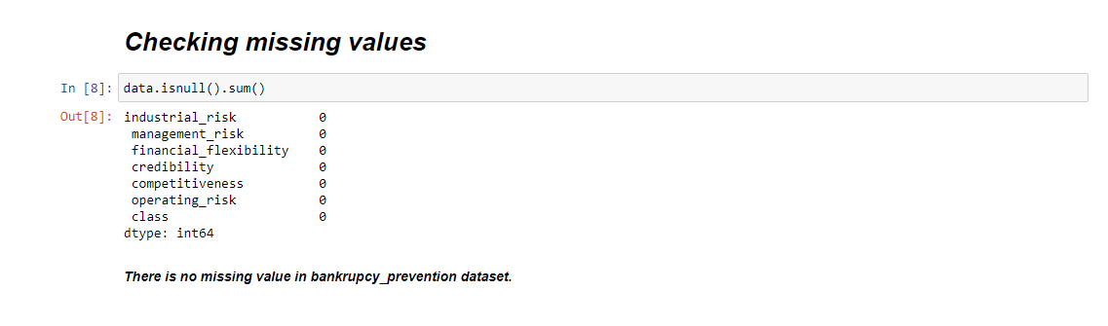
Missing Value

Slide 8
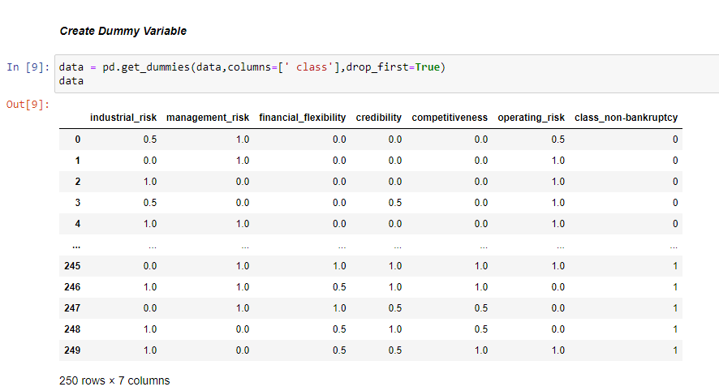
TRansformations
Creating dummy variable and changing the target variable to bankruptcy = 0 and non-bankruptcy=1

Slide 9
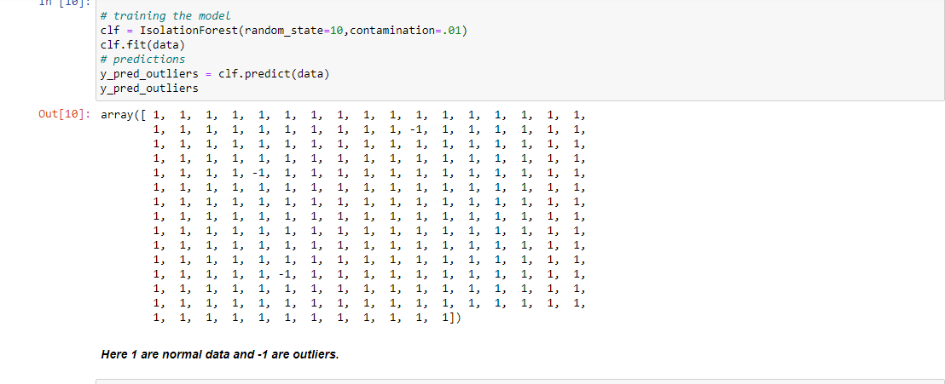
Outlier detection
Here the value -1 are outliers and 1 are normal data

Slide 10
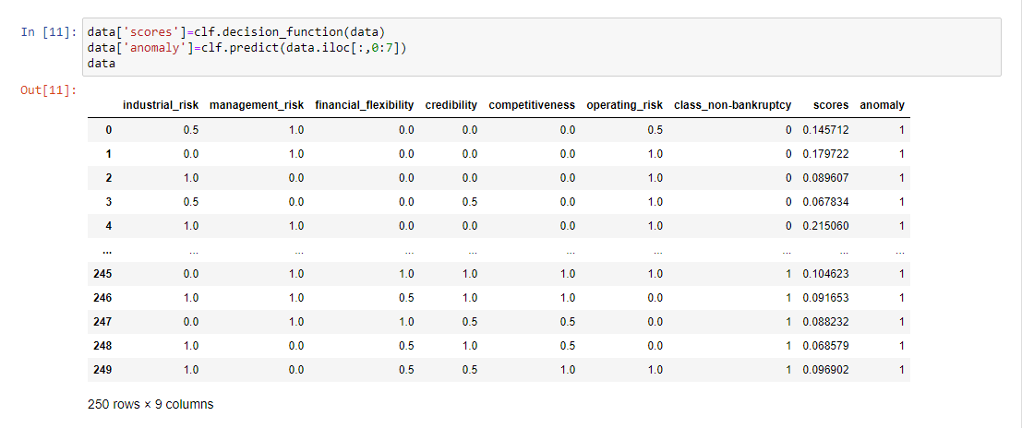
Scores and anomaly

Slide 11
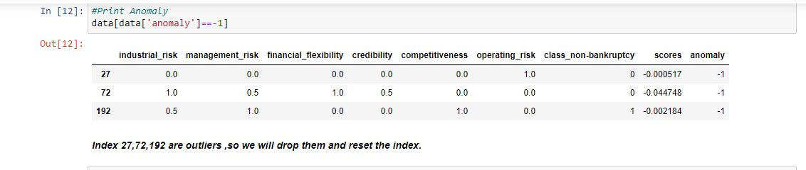
Display anomaly

Slide 12

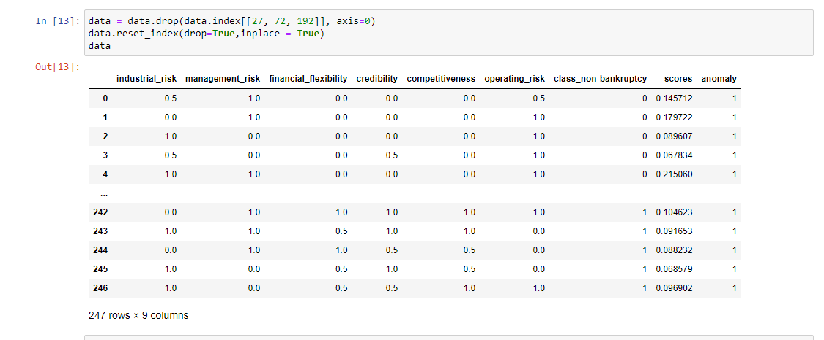
Feature Engineering After removing outliers the dataset has 247 rows and 9 columns

Slide 13

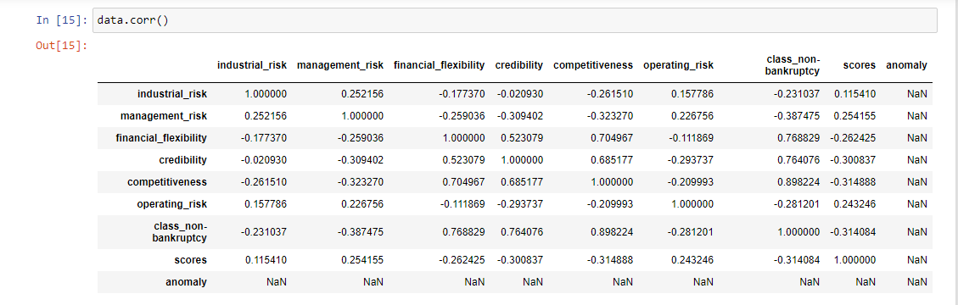
Correlation

Slide 14

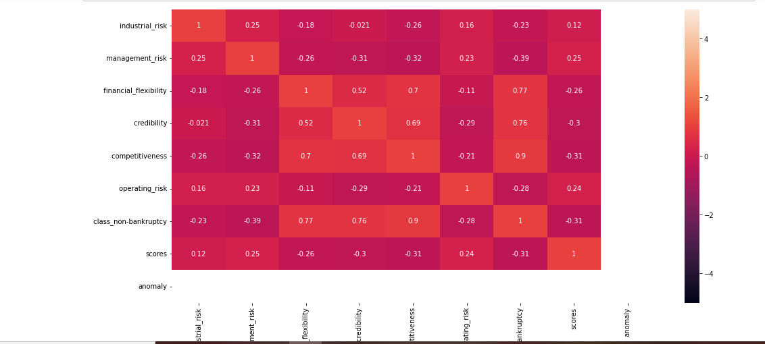
Heatmap

Slide 15
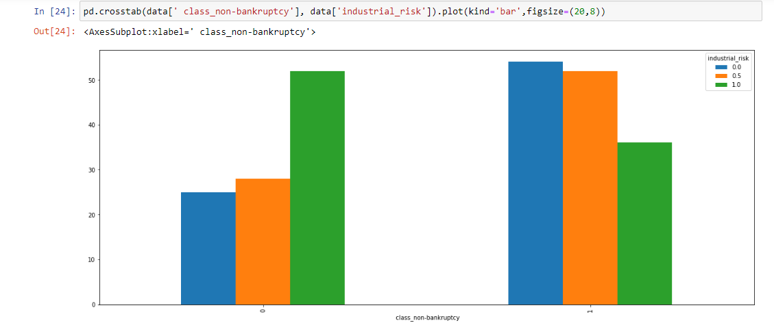
VISUALISATIONs

Slide 16
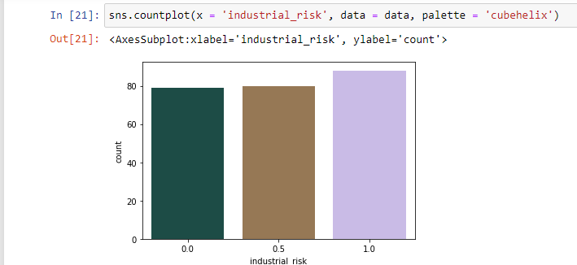
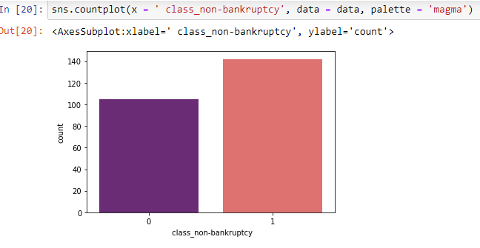
Visualisations

Slide 17
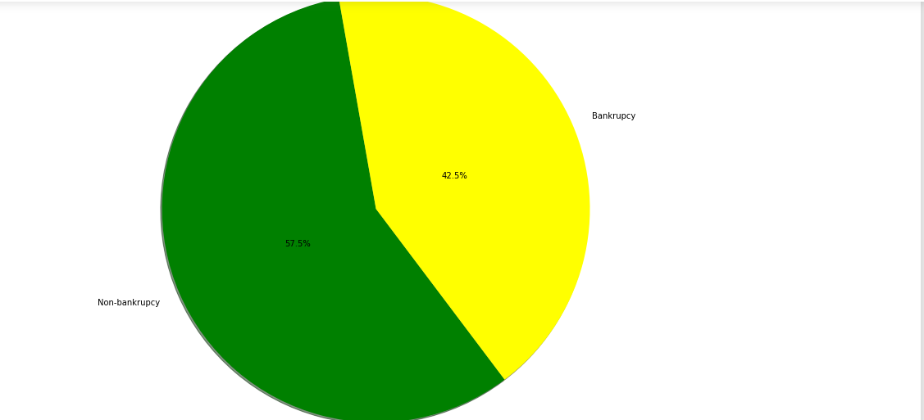
Percentage of bankruptcy=42.5% and non-bankruptcy = 57.5%

Slide 18
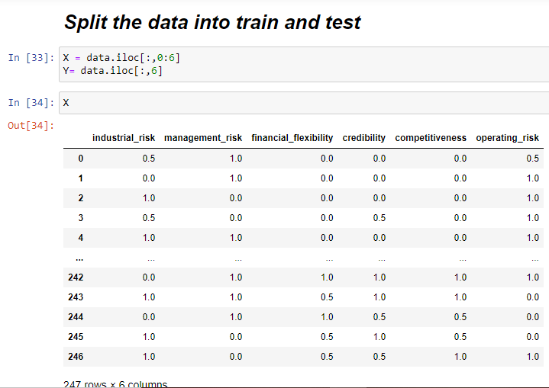
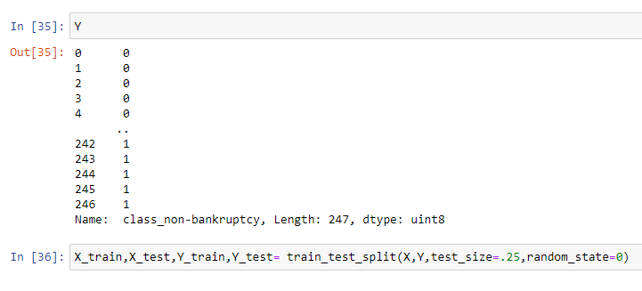
Train test split

Slide 19
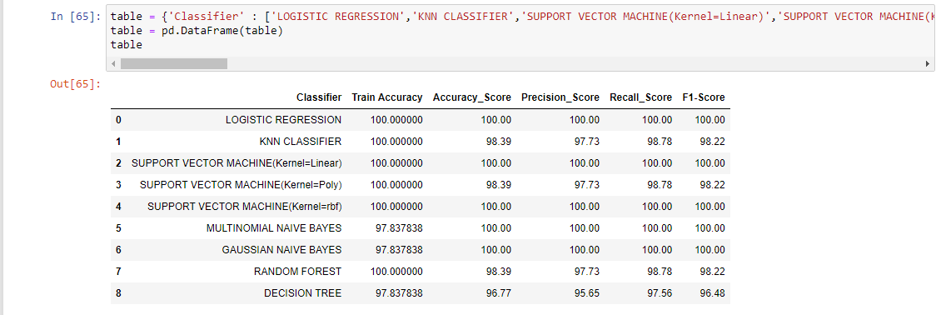
Model Building

Slide 20
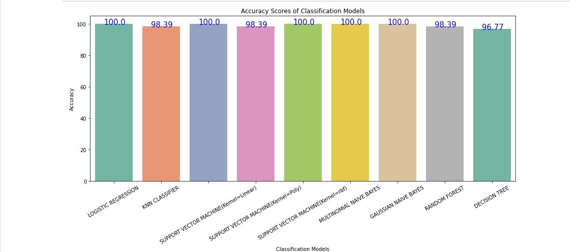
Accuracy scores of classification models

Slide 21

Model evolution
From the above model Logistic Regression, SVM(Kernel=Linear),SVM(Kernel=rbf), Naïve Bayes (booth multinomial and gaussian) gave the accuracy 100% and also precision, recall and f1 score of Logistic Regression, SVM(kernel=Linear), SVM(Kernel=rbf) gave 100%.
KNN Classifier , SVM(Kernel=Poly), Random Forest Classifier gave 98.39% accuracy.
Decision Tree Classifier gave 96.77 accuracy.

Slide 22
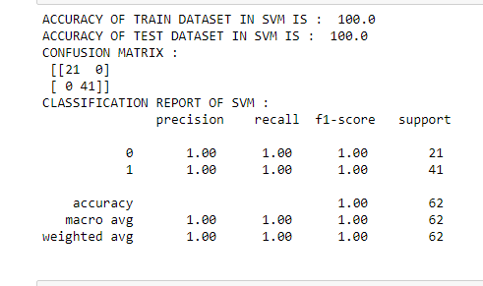
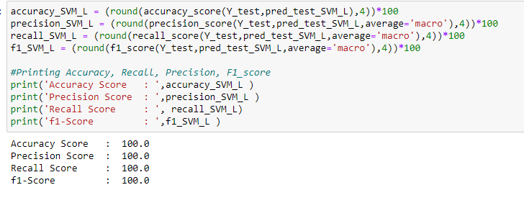
Model Evolution Report
Among the 8 models we choosed SVM(Linear) as final model because it gives 100 % accuracy and SVM is best for small dataset . SVM tries to find the best margin that separates the classes and reduces the risk of the error on the dataset .

Slide 23
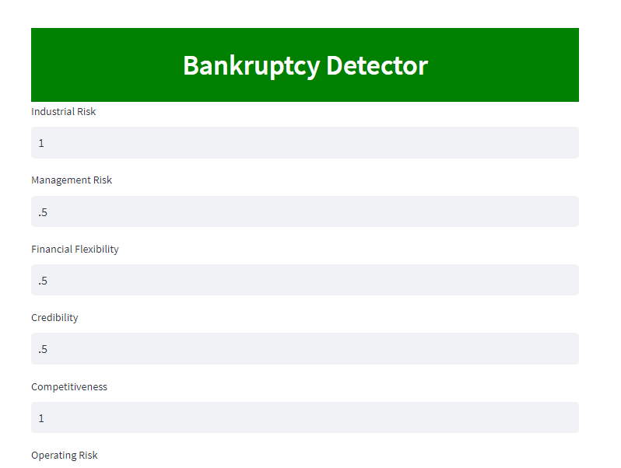
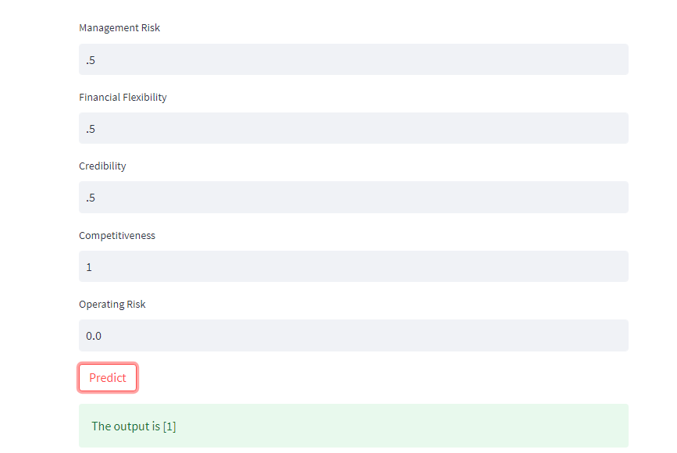
Deployment
Output is 1 that means it belongs to
to non-bankruptcy.

Slide 24

Challenges faced
We faced challenge to select the final model for best accuracy.
Deployment time that means to run streamlit web app.

Slide 25


